Slide 1
Sessions Recap
Data science for beginners

Slide 2
Where we’ve been

Slide 3
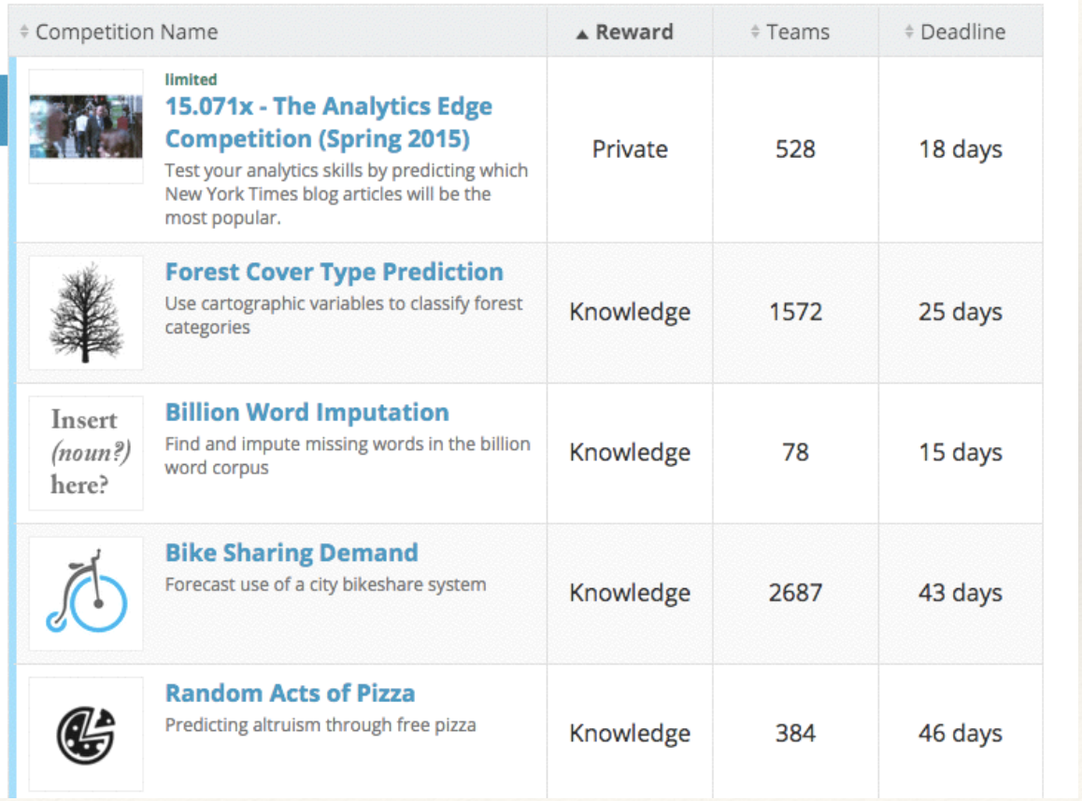
The Goal: Specify Data Problems
Notes:
Sometimes the best way to understand data scientists is to go look at what they do. This is the Kaggle competition list last year (Kaggle is one of the largest data science competition sites). Kaggle isn’t *all* that data scientists do - it focusses on the analysis and machine learning past of the process.

Slide 4
The Labs
People
Working with data science teams
Communicating results
Tools
Python basics
Enterprise data tools
Getting Data
Acquiring data
Cleaning and exploring data
Special data types
Handling text data
Handling geospatial data
Handling big data
Learning from data
Predicting values from data
Learning relationships from data
Learning classes from data
Notes:
The labs are grouped by theme. Why don’t we do them in this order? Because we want you to have some breathing space between the more difficult topics, and we want you to be able to do useful things as early in the course as possible.

Slide 5
The tools
Coding (Python, R)
Scrapers and cleaners (Tabula, OpenRefine)
Visualisation (Tableau, D3)
GIS (QGIS, CartoDb)
Big data (Hadoop)
Notes:
This toolset was chosen so you can still do something useful when you have no internet / have low bandwidth. There are many other tools out there if you have the bandwidth to run then, but at some point in your career you’ll find yourself somewhere like Arusha in Tanzania, desperately hoping that the page you need will load. We’ve based this toolkit on trying to minimise that experience.

Slide 6
The Process
Ask an interesting question
Get the data
Explore the data
Model the data
<sanity-check the data, in context>
Communicate and visualize the data
Notes:
We’ll use this process as the backbone of what we do on a data science project.

Slide 7
Where Next?

Slide 8
Keep doing projects
Your side projects
Your work projects
Kaggle - online datascience competitions
Driven Data - social good datascience competitions
Innocentive - some datascience challenges
CrowdAnalytix - business datascience competitions
TunedIt - scientific/industrial datascience challenges

Slide 9
Connect with communities
DataKind
Data & Society
Open Knowledge Foundation
Responsible Data Forum
Hacks/ Hackers
Data Driven NYC
BetaNYC
Notes:
DataKind: friday lunchtime talks
Data&Society: Whiskey Wednesday talks
OKFN: annual conferences
RDF: occasional seminars and meetings
Hacks/Hackers, Data Driven: regular meetups
BetaNYC: weekly drop-ins

